Slide 1
Supplier Integrations
PLATFORM OVERVIEW

Slide 2
What is SI
Booking Flow
Integration Model
Architecture Overview

Slide 3
What is SI?
HBG Platform
B2B / B2C Webs
Client
Supplier system
Client
SI platform
Supplier system
Client
Hotelbeds client api
Client
Supplier system
SI distribute the external product through the Hotelbeds platform to our clients

Slide 4
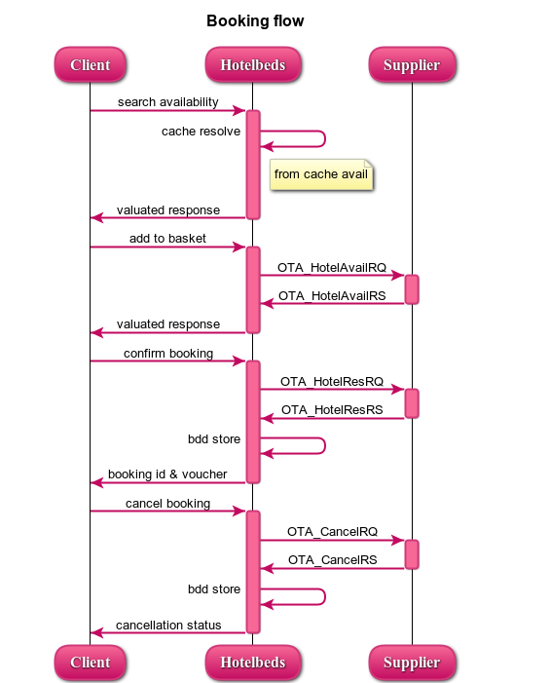
Standar Booking Flow

Slide 5
Standar Booking Flow
Avail RQ
Client sends an availability request to HB
ServiceAdd RQ (check rate)
Client selects one of the results
We make a live check on supplier for final availability & rates
Confirm RQ
Client send all the paxes information and payment order
We resolve from cache (or direct from supplier)
We return a list of available combinations
If still there is availability, we return fresh rates (including cancellation penalties and remarks)
If there is no more availability, we show ERROR
We generate an identifier for the booking and send it with all client data to supplier for booking confirmation
We store at database the booking reference
Cancel RQ
Client sends a cancellation request
Final identifier is sent back to client
We send a cancel request to supplier
If cancellation is OK, we return this to client (with cancellation reference, if any)
We cancel at HB database only if supplier’s cancellation is OK.
If we get an ERROR, it’s returned to client
If cancellation is KO or ERROR, we send back ERROR and don’t cancel on our side.
In supplier’s timeout case, we return ERROR to client but wait for supplier to rollback the booking (auto-cancel)

Slide 6
Integration types
We classify integrations based on connectivity with supplier for the booking flow operations.
We have 3 main types: Direct, Scan (Pull) & Push
We can distribute product requests in any of the 3 types (hybrid integration)

Slide 7


Integration types
Direct Integration
Availability & rates requests
Service Add (live check for fresh availability & rates)
Hotelbeds Database (Atlas)
Supplier’s system
Clients
Booking
Confirmation
Cancellation
Confirmation
Cancellation

Slide 8
Integration types
Direct Integration
Completely real-time: what client see, is what we get.
Pros
Cons
Completely depending on externals traffic capacity.
No need to store information in our systems.
Low operational maintenance.
Allow high number of hotels
Not available on all suppliers and clients.
Very limited response time (time-out very low) to be effective.

Slide 9
Integration types
Scan Integration (Pull)
(Caronte)
Cache
Availability & Rates
Requests for
Rates & Avail
Requests for
Rates & Avail
Update Availaibility & Prices
Service Add (live check for fresh availability & rates)
Hotelbeds Database (Atlas)
Clients
Supplier’s system
Booking
Confirmation
Cancellation
Confirmation
Cancellation

Slide 10
Integration types
Scan Integration (Pull)
A very common Integration type among suppliers.
Pros
Cons
Sequential information gathering: slow process (not the best option for large volume of hotels).
Scanning adapted to our needs (agreed with supplier).
No dependencies on externals.
Price & Avail on AddService and Confirmation may vary.
Need to store all the information.

Slide 11
Integration types
Inventory Update Integration (Push)
(Caronte)
Inventory
Rates, Avail & Rules
Push
ARI
Requests for
Rates & Avail
Updates Rates & Avail
Service Add (check for fresh rates & avail)
BDD Hotelbeds (Atlas)
Supplier’s System
Clients
Booking
Confirmation
Cancellation
Confirmation
Cancellation

Slide 12
Integration types
Inventory Update Integration (Push)
Suitable for large volume of hotels.
Pros
Cons
Dependencies on externals: they push the updates.
Information updates are externals responsibility.
If needed to refresh ARI, can be done instantly.
Desynchronisation on the ARI loaded.
Need to store all the information.

Slide 13

Integration types
Types comparison
 | Direct | Scan | Push
Rely on supplier’s response time | High | Low | Minimal
Ratio look-to-book | High | Medium | Low
Number of hotels | Maximum | Medium | High
Operational cost for configuration at HB side | Minimal | Medium | Low
Risk of desynchronization | Minimum | Medium | Medium
Number of availability requests sent to supplier | Maximum | Controllable | Minimal
Storage at HB cache | No | Yes | Yes
Additional development required at supplier’s side | No | No | Yes
Product available for all HB clients | No | Yes | Yes

Slide 14
Platform overview
hsi20
caronte-web-ari-db
caronte-web-cache
Update product configuration
Overrides
Replicated caches
Lazy cache
Send ARI updates
Persist ARI
CacheApi
Push ARI changes
Push static data
Hotel-ari-si-service
HASS
sih-distribution
Get ARI
Send ARI updates
Check for avail
GET ARI hotel rate
Webs
client
supplier system
Availability
Check avail & rates
Booking confirmation
Booking cancellation
Availability
Check avail & rates
Availability
Check avail & rates
Booking confirmation
Booking cancellation
caronte-web
HDS
Booking confirmation
Booking cancellation
sih-* (plugin)
Client API
Pricing
loaders
Ace-hotel-daemon
SI Bookings
Product configuration
Pull ARI
Pull availability
Pull static data
Pull booking list
Check avail & rates result
Atlas (Oracle)
ARI refresh
caronte-scan
hotel-feedback-ari-service

Slide 15


On Premise
AWS
BT – Madrid
EUR - Irlanda
USA – N. Virginia
Asia - Singapore
Caronte-Web 47 servers
Caronte-Scan 10 servers
HSI20 5 servers
HASS 16 servers
SIH-Distribution 10 servers
Redis
Caronte-Web 105-160 servers
HASS 20 -60 servers
SIH-Distribution 15-40 servers
Redis
Caronte-Web 45-70 servers
HASS 15 -40 servers
SIH-Distribution 7-15 servers
Redis
Caronte-Web 20-32 servers
HASS 10 -20 servers
SIH-Distribution 7-15 servers
Redis

Slide 16
SINCRONIZATION
On Premise
AWS
BT – Madrid
EUR - Irlanda
USA – N. Virginia
Asia - Singapore
KAFKA

Slide 17

Availability flow
Availability request
Distribution
Availability engine
Filtering
Pricing
Prepare results

Slide 18
Availability request
Availability request
Distribution
Availability engine
Filtering
Pricing
Prepare results
HDS send us requests for availability to the different regions
We receive almost 60K request per second.
BT-Madrid: 7K r/s
AWS-EU: 26K r/s
AWS-USA: 15K r/s
AWS-SIN: 10K r/s
Hotel Distribution service
Caronte-Web

Slide 19
Distribution
Availability request
Distribution
Availability engine
Filtering
Pricing
Prepare results
Caronte-web request to SIH-Distribution for the valid HotelRates
The HotelRates can be filtered by distribution rules
or automatic disconnexions
Caronte-Web
SIH-Distribution

Slide 20
Availability engine
Availability request
Distribution
Availability engine
Filtering
Pricing
Prepare results
Caronte-Web
Hotel ARI SI Service
Plugins
SIH-*Plugins
ARI Cache
Providers

Slide 21
Filters and aggregator
Availability request
Distribution
Availability engine
Filtering
Pricing
Prepare results
Caronte-Web
In this phase duplicated rooms and rooms not configured for CacheAPI are filtered

Slide 22
Pricing
Availability request
Distribution
Availability engine
Filtering
Pricing
Prepare results
Caronte-Web
ACE
Request to ACE for valuated amounts

Slide 23
Prepare results
Availability request
Distribution
Availability engine
Filtering
Pricing
Prepare results
Caronte-Web
Prepare the availability response
Some rooms can be filtered by inconsistent information

Slide 24
Check Rates flow
Check Rate request
Distribution
Availability engine
Filtering
Pricing
Prepare results

Slide 25
Check rate request
Check Rate request
Distribution
Availability engine
Filtering
Pricing
Prepare results
HDS send us requests for check rate in BT-Madrid
We receive 60 request per second.
Hotel Distribution service
Caronte-Web

Slide 26
Distribution
Check Rate request
Distribution
Availability engine
Filtering
Pricing
Prepare results
Caronte-Web
SIH-Distribution

Slide 27
Availability engine
Check Rate request
Distribution
Availability engine
Filtering
Pricing
Prepare results
SIH-*Plugins
Caronte-Web
Providers
Plugins

Slide 28
Filters and aggregator
Check Rate request
Distribution
Availability engine
Filtering
Pricing
Prepare results
Caronte-Web
In this phase duplicated rooms and rooms not configured for CacheAPI are filtered

Slide 29
Pricing
Check Rate request
Distribution
Availability engine
Filtering
Pricing
Prepare results
Caronte-Web
ACE
Due this operation we need to do the checkRate in BT-Madrid

Slide 30
Prepare results
Check Rate request
Distribution
Availability engine
Filtering
Pricing
Prepare results
Caronte-Web
Prepare the check-rate response
Generate booking key to the next operation

Slide 31
Confirm simulation flow
Simulation request
Generate booking id
Generate VCC
Provider simulation

Slide 32
Simulation request
Simulation request
Generate booking
Generate VCC
Provider simulation
HDS send us requests for confirmation simulation
only in BT-Madrid
Hotel Distribution service
Caronte-Web

Slide 33
Generate Booking
Simulation request
Generate booking
Generate VCC
Provider simulation
Need to generate booking id (called ApeironBookingId)
This operation it’s only available in BT-Madrid
Database
Caronte-Web
Atlas
(Oracle)

Slide 34
Generate VCC
Simulation request
Generate booking
Generate VCC
Provider simulation
Send request to GVCC in order to create a new VCC
Needed to confirmate the booking
Caronte-Web
GVCC

Slide 35
Provider simulation
Simulation request
Generate booking
Generate VCC
Provider simulation
SIH-*Plugins
Caronte-Web
Only if the provider requires this operation
Providers
Plugins

Slide 36
Confirmation flow
Confirmation request
Provider confirmation
Update booking status

Slide 37
Confirmation request
Confirmation request
Provider confirmation
Update booking status
HDS send us requests for confirmation only in BT-Madrid
Hotel Distribution service
Caronte-Web

Slide 38
Provider confirmation
Confirmation request
Provider confirmation
Update booking status
SIH-*Plugins
Caronte-web sends the confirmation request to the providers.
Generate one booking per provider.
Caronte-Web
Providers
Plugins

Slide 39
Update booking status
Confirmation request
Provider confirmation
Update booking status
Database
If the response is successful, we need to update our booking record with provider’s booking id.
Caronte-Web
Atlas
(Oracle)

